Slide 1

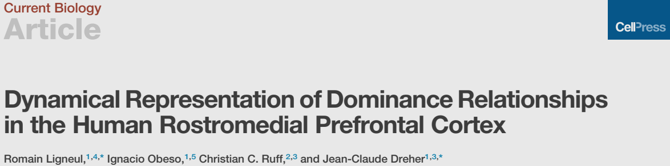
文献分享
December 2016
Reporter：Chunlei Lu
2022.02.11

Slide 2
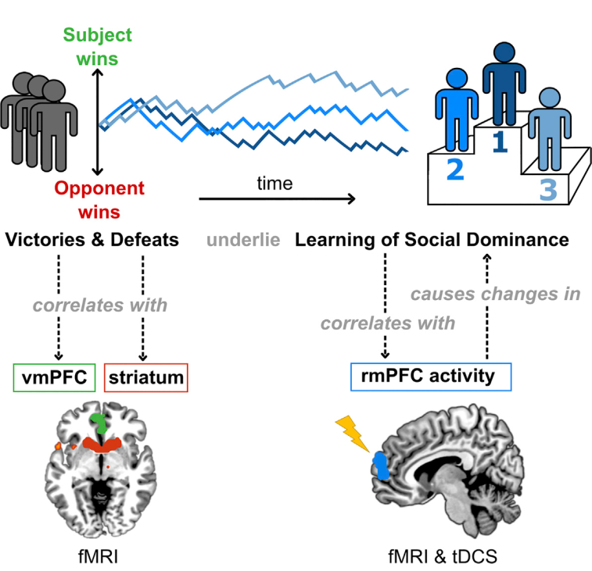
Overview
- 1 -

Slide 3
Introduction
Social dominance hierarchy
Mental disorders
Brain processes of tracking dominance relationships
- 1 -
Notes:
社会支配等级——普遍存在，有重要的演化意义
心理疾病
因此探讨大脑对支配关系的加工，可能有利于对这些疾病的治疗

Slide 4
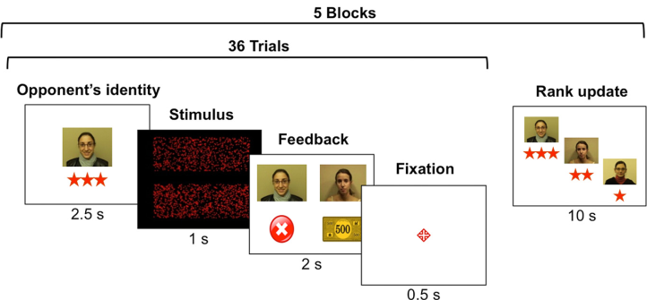
Introduction
Using pre-established ranks
Santamaría-García, H., Burgaleta, M., & N Sebastián-Gallés, N. (2015). Neuroanatomical markers of social hierarchy recognition in humans: a combined ERP/MRI study. The Journal of Neuroscience
- 1 -

Slide 5
Introduction
rostromedial prefrontal cortex (rmPFC)
learning dominance relationships (ref. 16-20)
- 1 -
Notes:
因此当前也就也这么假设着

Slide 6
Current study
Reinforcement learning (RL)
Neuroimaging (fMRI, Exp. 1, N = 22)
brain stimulation (tDCS, Exp. 2, N = 34)
rmPFC - social dominance relationships
- 1 -

Slide 7
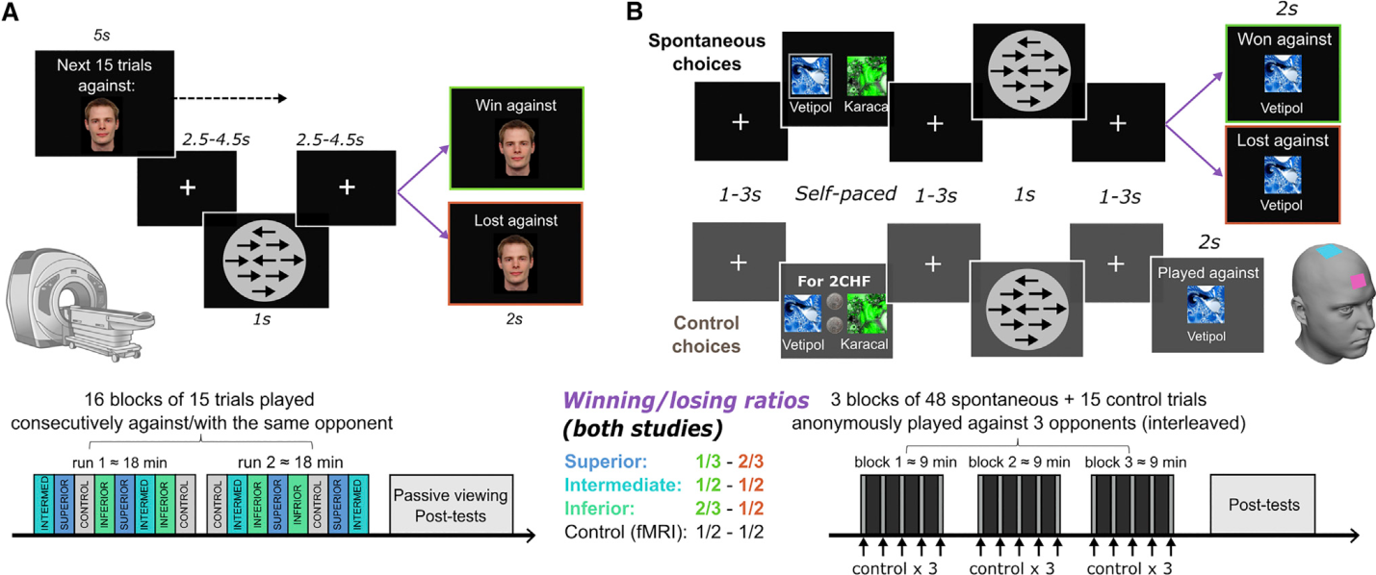
Design
Fig. 1 Experimental Procedures
- 1 -
Notes:
‘‘If both responses are correct, the fastest player wins. If one player gives an incorrect response, the accurate /thumbsup
player wins. If both responses are incorrect, the slowest player wins. If one player doesn’t respond, then he loses automatically.’’
那如果被试直接没反应呢？ 而系统已经设置了他赢？
以及刺激实际呈现的内容是什么？
They were told that the trial would result in a shared win or loss if both players responded in the same direction or opposite directions, respectively.
还是不知道更细致的计算机反馈的序列是怎样的~~~

Slide 8
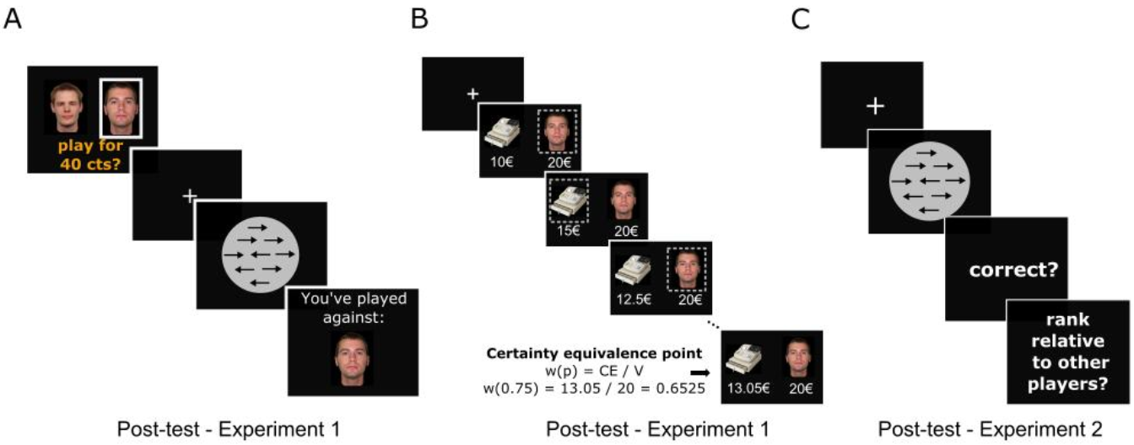
Design
Fig. S1 Complementary behavioral tasks
- 1 -

Slide 9
Results
Behavioral Evidence for Social Dominance Learning
Neural Correlates of Social Dominance Learning: Experiment 1
The Impact of rmPFC Electrical Stimulation on Social Dominance Learning: Experiment 2
- 1 -

Slide 10
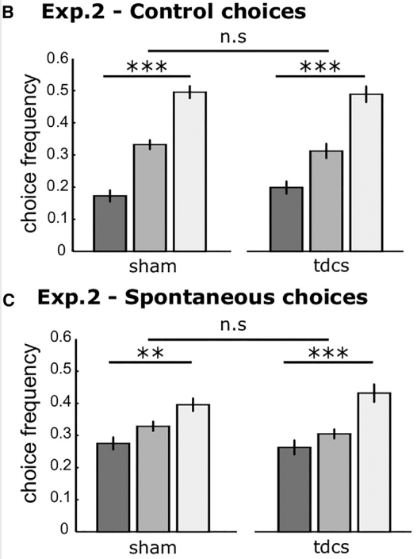
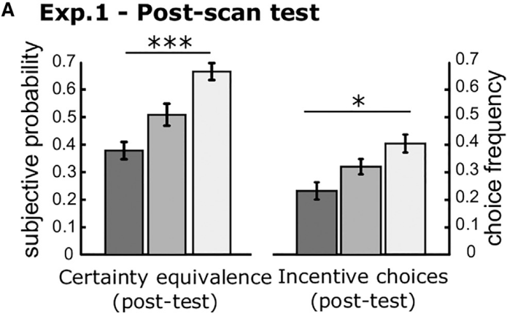

Results
Behavioral Evidence for Social Dominance Learning
- 1 -

Slide 11
fMRI Analyses
GLM1
trial-by-trial variables (cPEs & SDSi) derived RL
SDSi: social dominance status
cPE: competitive prediction error
GLM2
victories and defeats against superior
intermediate, and inferior opponents
GLM3
- 1 -

Slide 12
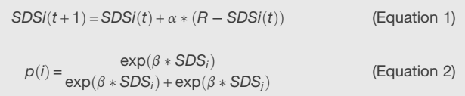

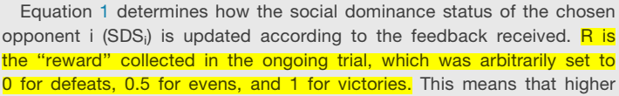
Reinforcement-Learning Modeling
SDSi (social dominance status)
anticipated probability of winning against each opponent-i
- 1 -

Slide 13
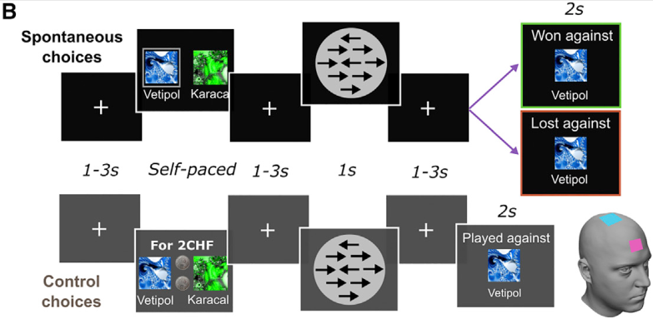
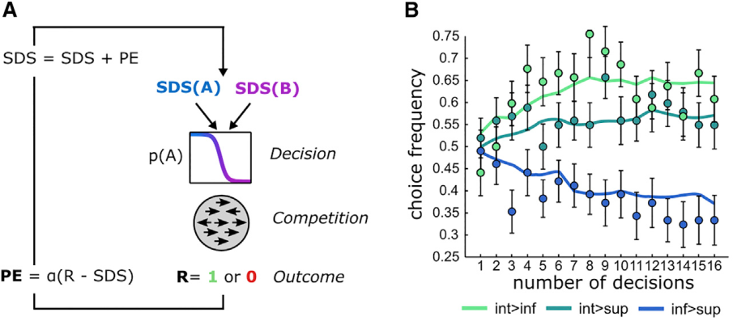
Reinforcement-Learning Modeling
Figure 5
- 1 -
Notes:
(B) Observed choices (dots) and modeled choices (lines) in the spontaneous trials (merged across sham and tDCS groups for display purposes).

Slide 14
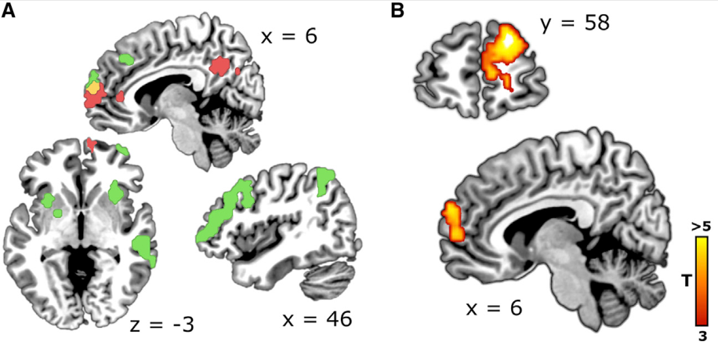
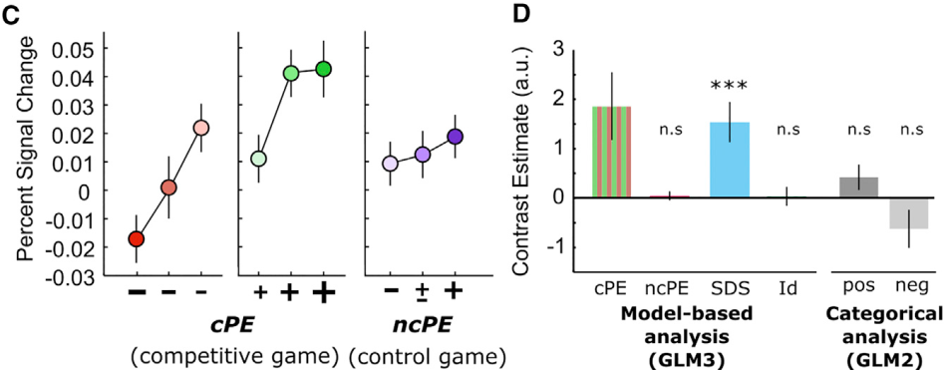
Results
Neural Correlates of Social Dominance Learning: Experiment 1
Figure 3. Encoding of Competitive Prediction Errors in the rmPFC
- 1 -

Slide 15
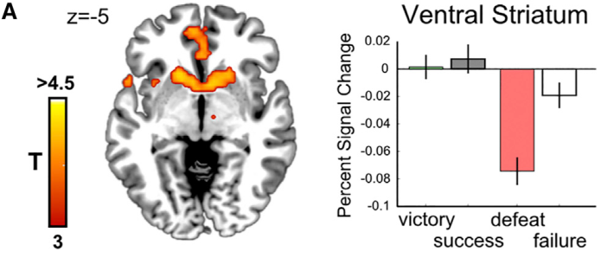
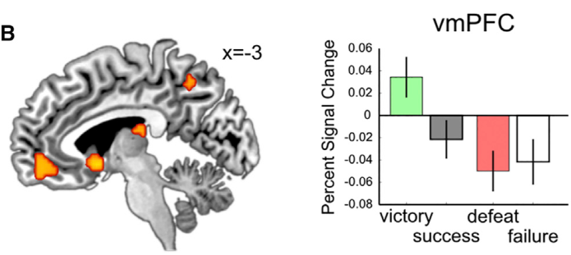
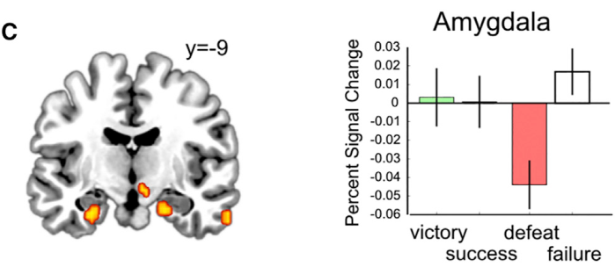
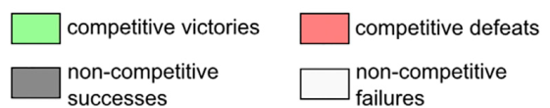
Results
Neural Correlates of Social Dominance Learning: Experiment 1
non-parametric approach (GLM2)
Figure 4. Interaction between Positive versus Negative Outcomes and Collaborative versus Competitive Games
- 1 -

Slide 16
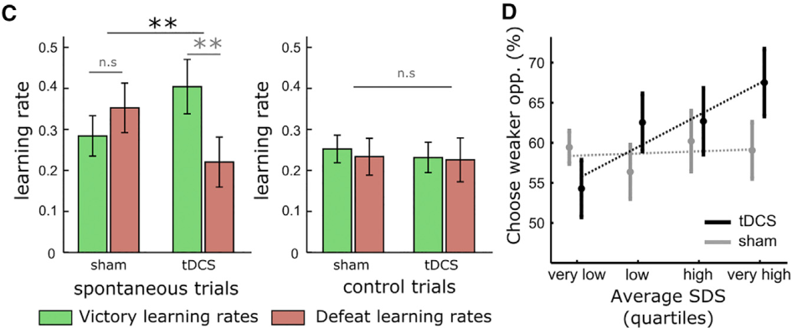
Results
The Impact of rmPFC Electrical Stimulation on Social Dominance Learning: Experiment 2
Figure 5. Effects of tDCS on Social Dominance Learning
- 1 -
Notes:
(D) Significant interaction between the averaged SDS and stimulation group (black, tDCS; gray, sham) in the proneness to select the weaker opponent. Subjects under rmPFC tDCS alternated between periods in which they challenged superior opponents despite increased frequency of defeats (low averaged SDS) and periods in which they consistently challenged inferior opponents despite having already established their dominance (high averaged SDS).
——只看control trails

Slide 17
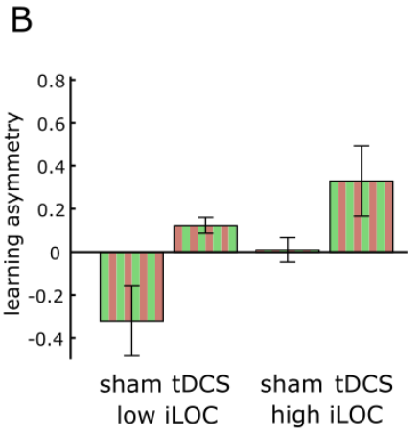
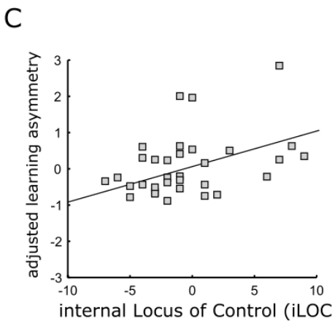
Results
The Impact of rmPFC Electrical Stimulation on Social Dominance Learning: Experiment 2
Figure S3
- 1 -
Notes:
Complementing this key finding, we observed that the degree of learning asymmetry (corrected for tDCS effects) was correlated with the internal locus of control (iLOC) scale across subjects, so that subjects with a higher sense of control weighted victories more and defeats less on average
有趣的发现——but 样本量 太小~ 结论有待验证！

Slide 18
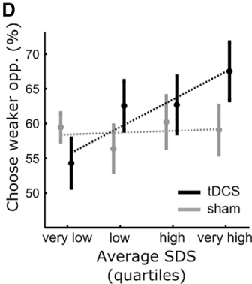
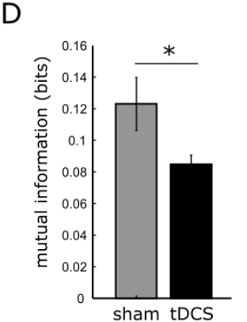
Results
The Impact of rmPFC Electrical Stimulation on Social Dominance Learning: Experiment 2
Figure S3
- 1 -
Notes:
Complementing this key finding, we observed that the degree of learning asymmetry (corrected for tDCS effects) was correlated with the internal locus of control (iLOC) scale across subjects, so that subjects with a higher sense of control weighted victories more and defeats less on average
有趣的发现——but 样本量 太小~ 结论有待验证！

Slide 19
Summary
- 1 -

Slide 20
Discussion
rmPFC ~ others ~ competitive contexts
peak coordinates of cPE
effect of tDCS ~ Sense of control
other brain regions
ventral striatum
amygdala
- 1 -

Slide 21
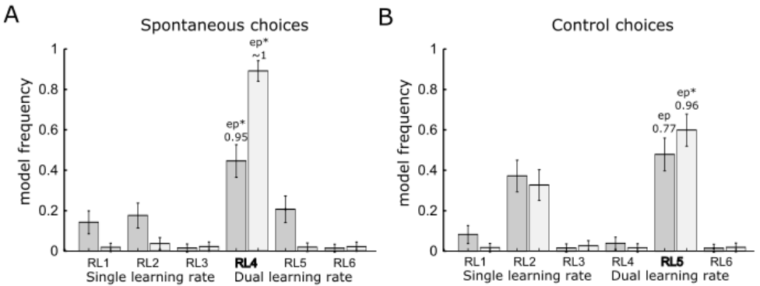
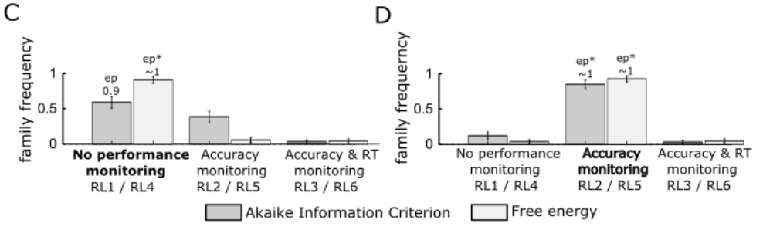
Model comparison
- 1 -

